Slide 1


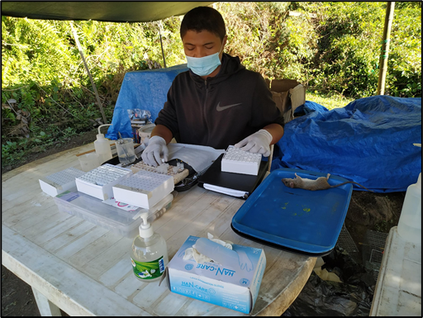


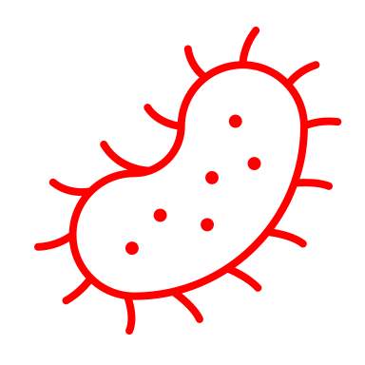

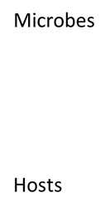






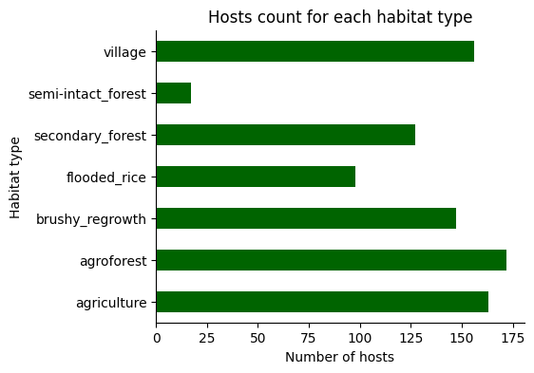
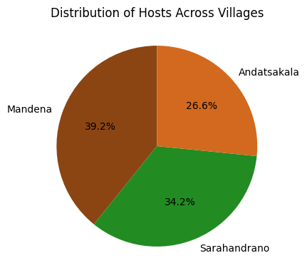
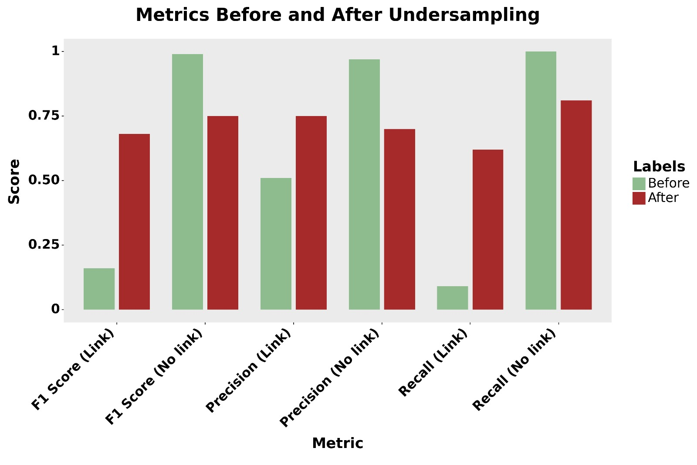

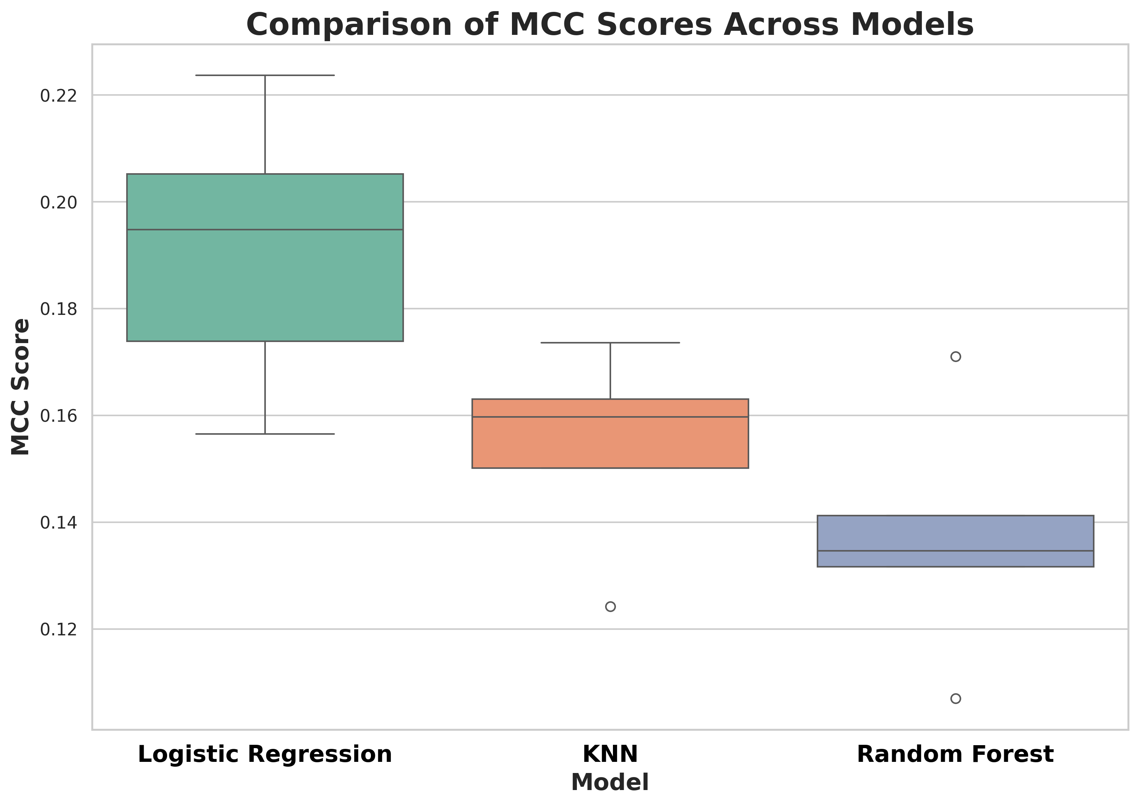
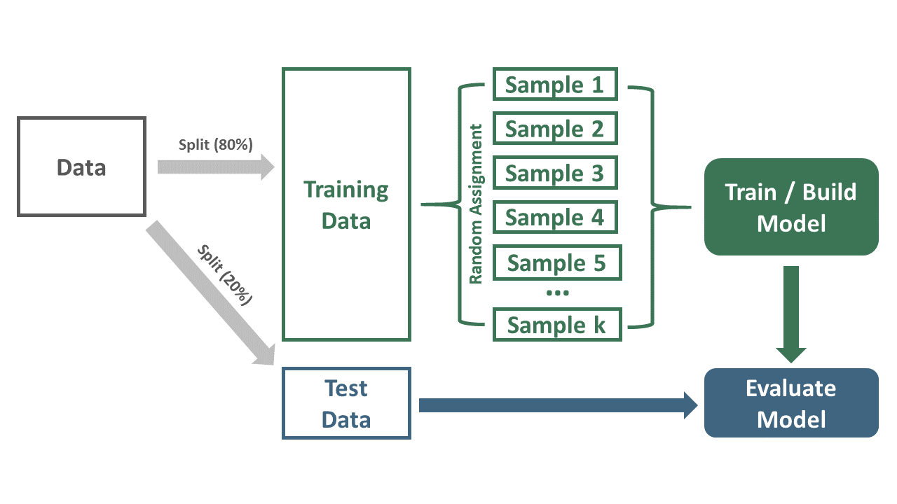
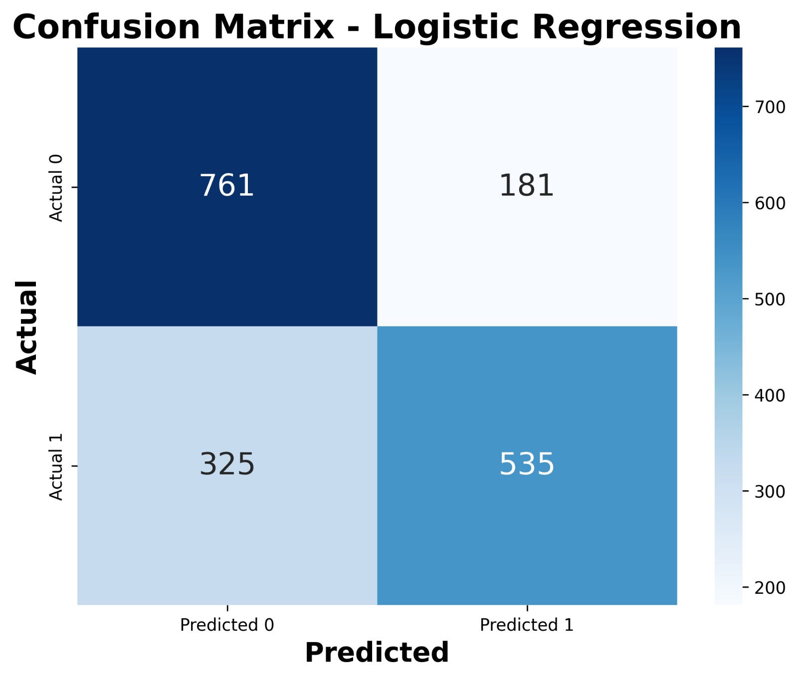
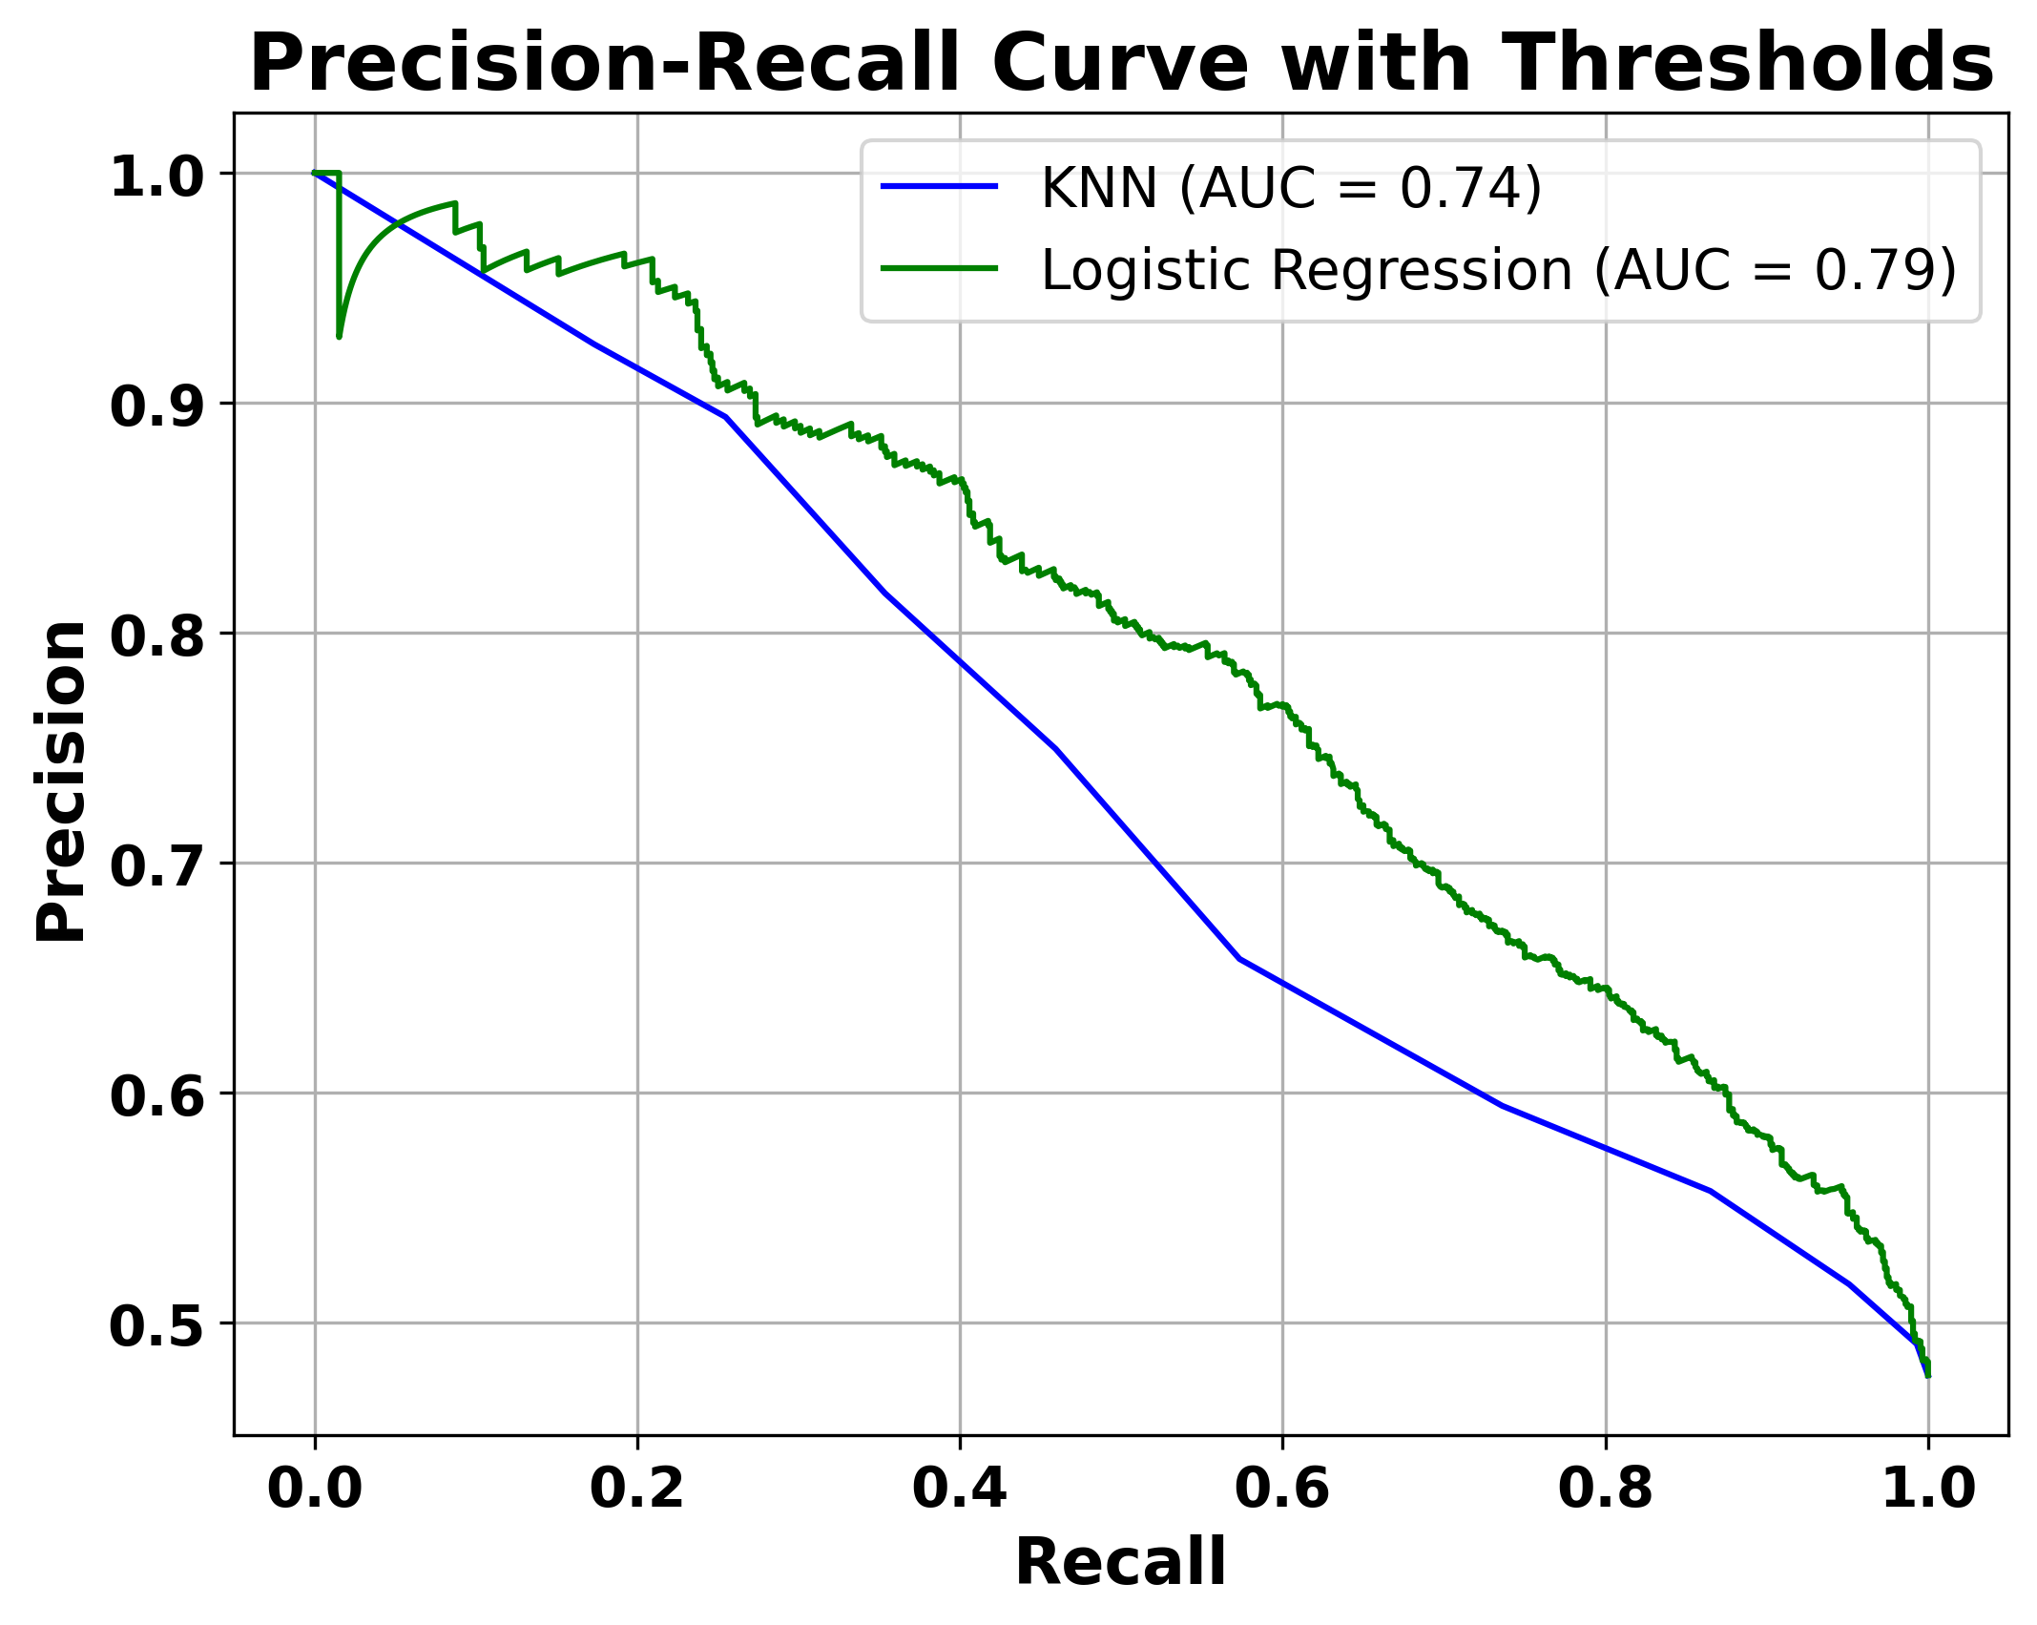
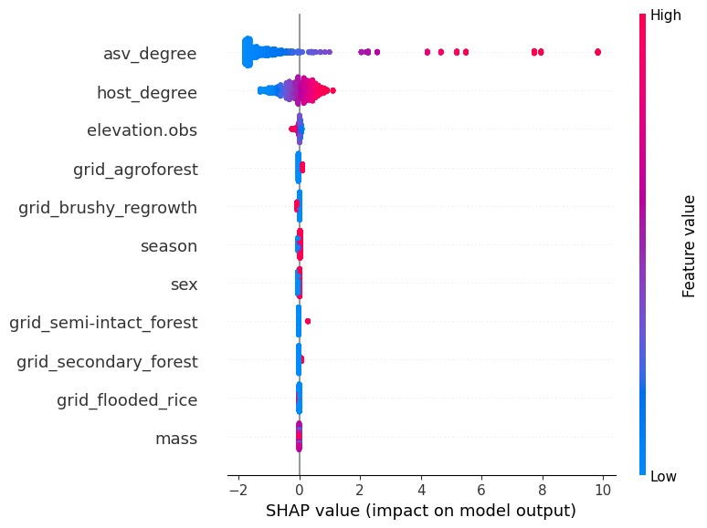






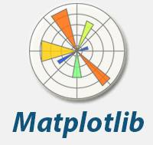



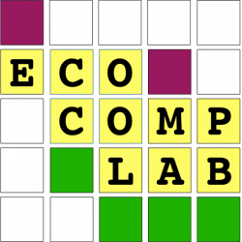
הפקולטה למדעי הטבע
המחלקה למדעי המחשב
Host-Microbe link prediction in Madagascar
עדן ברסלר, אופיר גורמס
מנחים: ד"ר שי פילוסוף, פרופ' חן קיסר
Motivation
Project Goals
Understanding host-microbe interactions in a natural environment
Predicting links between microbes and their hosts
Identifying influential features in these connections
Background
Ecosystems are shaped by interactions that drive changes, maintain diversity, and help understand disease transmission.
Microbes-host interactions are important because they drive the host's ecology. However, they are difficult to sample.
One solution is to predict links, but this has not yet been done in mammals in the wild.
Approach - Machine Learning
Results
EDA (Exploratory Data Analysis)
Prediction
Our model predicts host-microbe link with an F1-score of approximately 70%-75%.
Choosing a ML model
Training the model
Evaluating model prediction
Features Impact
The degrees of hosts and microbes are the most important features in predicting host-microbe interactions.
Tools
Acknowledgements
We thank Ecological Complexity lab members and our collaborators, especially Matan Markfeld, Itamar Talpaz, Barry Biton, Geut Galai. This study was funded by NSF-BSF and NIH grants.

